Slide 1
From Whole Genome Sequencing toward precision medicine: A preliminary case study in EGFR
Wanlin Zheng
Josh Bloomstein
Eric Danziger
Stephanie Kinnunen
Team: HIF1a is not an oncogene

Slide 2
Identification of mutations using our patient dataset SNP-FF

Slide 3
Multiple mutations in EGFR signaling pathway
Functional Proteomics to dissect tyrosine kinase signalling pathways in cancer, Kolch et al., Nature Reviews Cancer, 2010.

Slide 4
Oncotype DX 21 gene breast cancer panel
HER2 RT-PCR
Small gene panels may not include mutation information on driver genes

Slide 5
Hierarchical clustering of TCGA KIRP yields subtypes

Slide 6
TCGA All genes Principal component analysis

Slide 7
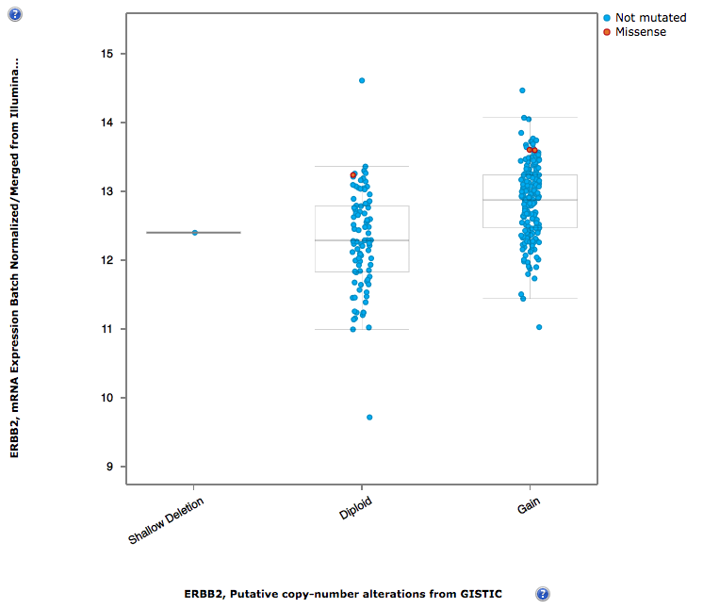
TCGA KIRP Copy Number Variation gain may be associated with higher mRNA expression of HER2 (ERBB2)
cBioPortal

Slide 8
TCGA KIRP RNA-Seq Cox Proportional Hazard Model
Surv(Death, Followup days) ~ Gene
Notes:
CDK4 cell cycle, E2F2 transcription, FGFR1 growth factor, MAPK8 (ERK) signal transduction, MS

Slide 10
Future directions
Creating a pathway differential expression score to apply to patients
Selected 5 gene sets from Broad Hallmarks database, within categories that patient has mutation
Pathways:
1. IL-6-JAK-STAT3-signaling
2. KRAS signaling up
3. p53 pathway
4. Hypoxia signaling
5. PI3K Akt mTOR signaling

Slide 11
Principal Component Analysis of TCGA KIRP patients by pathway activation score
Low IL-6
Colors represent gross activation of cancer-related pathways
Each group is a combination of high/low of 5 pathway sets
Use feature selection and machine learning to models for predicting clinical outcomes in KIRP

